Slide 1


ALMOST EVERYTHING YOU NEED
TO WIN DWI TRIALS
Mark Ryan Thiessen
The Thiessen Law Firm
733 E. 12 ½ Street
Houston, Texas 77008
mark@thetexastrialattorney.com
Cell: (832) 654-3058

Slide 2
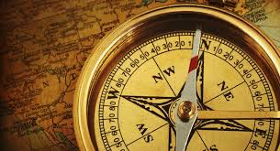
PRESUMPTION + RD =
NOT GUILTY
Innocent Unless Proven Guilty
1-----→ 10
ONLY ONE PRESUMPTION
Compass takes you Home

Slide 3

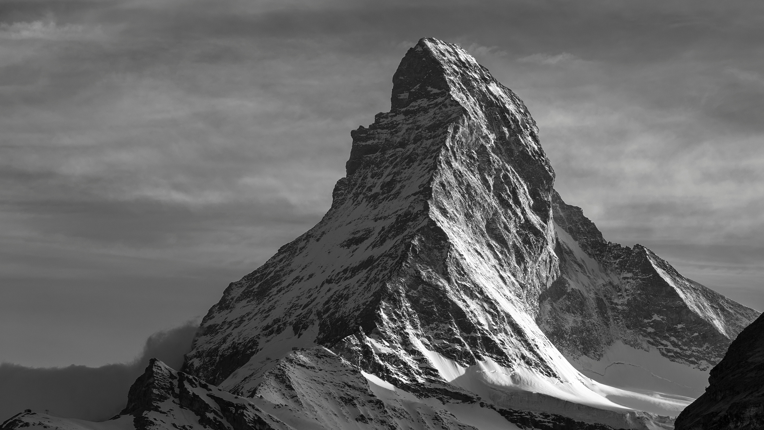


BEYOND A REASONABLE DOUBT
BURDENS
OF
PROOF
CLEAR AND CONVINCING
PREPONDERANCE
PROBABLE CAUSE
REASONABLE SUSPICION
SCINTILLA
NO EVIDENCE
Notes:
Next, is reasonable suspicion. This part of the mountain trek is the part the kids can make it to. You have started to make the hike, but you really haven't made it that far. It's still not too late to turn around...
In legal sense, we look at this as what an officer has to stop someone. If you are walking down the street in the middle of Texas summer with a ski mask and a trench coat, that's reasonable suspicion to stop you. However, if it is the Texas winter like we have been experiencing, its a little more justified.

Slide 4
Beyond (if you went beyond your exit?)
A (how many pineapples do you have?)
Reasonable(phone a friend?)
Doubt (before you jump in a pool?)

Slide 5


BEYOND A REASONABLE DOUBT
A Reasonable
Doubt
BURDENS OF PROOF
CLEAR AND CONVINCING
PREPONDERANCE
PROBABLE CAUSE
REASONABLE SUSPICION
SCINTILLA
NO EVIDENCE
Notes:
Next, is reasonable suspicion. This part of the mountain trek is the part the kids can make it to. You have started to make the hike, but you really haven't made it that far. It's still not too late to turn around...
In legal sense, we look at this as what an officer has to stop someone. If you are walking down the street in the middle of Texas summer with a ski mask and a trench coat, that's reasonable suspicion to stop you. However, if it is the Texas winter like we have been experiencing, its a little more justified.

Slide 6
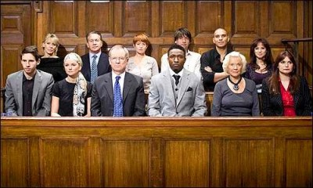
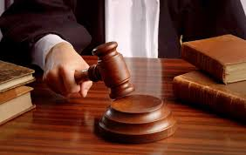
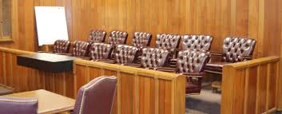
JURY SERVICE

Slide 7
BE PROUD
OF
YOUR VERDICT

Slide 8
HGN PC LOOP MOTION
TOTALITY OF THE CIRCUMSTANCES?
  What Does It Mean?
DRIVING
  22 Cues of Intoxicated Driving
  Speeding Not An Indicator
  No PC
CONTACT
  Stopped Safely/Timely
  DL/INS
  Odor/ Admission/ Eyes/ Speech
  No PC
HGN
  Eyes Don’t Lie
  Honestly… PC
  Administration of HGN (3rd Prong of Kelly)

Slide 9
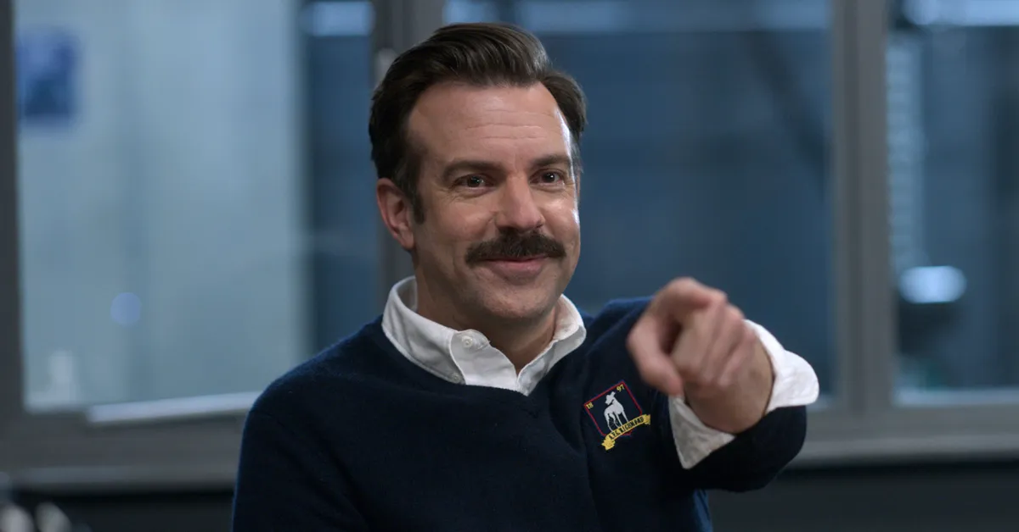

Slide 10
EDUCATE ABOUT SFSTs
Officer Training
  40 hour course,
  Graded at end,
  Credit for Correct Answers
HGN
  Trained by Fellow Police Officers
  Highly Technical,
  88 Types,
  Doesn’t Measure Mental or Physical
  No Definition of How Far/ How Many Jerk
  HGN Demo

Slide 11
TRE 803(18) Learned Treatise
EXCEPTIONS TO HEARSAY:
(18) Statements in Learned Treatises, Periodicals, or Pamphlets. A statement contained in a treatise, periodical, or pamphlet if:
  (A) the statement is called to the attention of an expert witness on cross-examination or relied on by the expert on direct examination; and
(B) the publication is established as a reliable authority by the expert’s admission or testimony, by another expert’s testimony, or by judicial notice.
If admitted, the statement may be read into evidence but not received as an exhibit.

Slide 12
I’M NOT HERE TO BUST YOUR CHOPS

Slide 13
HGN
Training: Ophtalmologist, Optometrist, Lens Crafters, Anyone in A White Lab Coat
88 Different Types of Nystagmus
  Bruns, latent, pendular, vestibulo ocular, spasmus, or rebound
Wet Lab only showed HGN
  Optokinetic, rotational, post rotational, caloric, positional
Variety of Reasons

Slide 14
HGN
How far do the eyes have to jerk? ( __mm)
How many times do they have to jerk? (__x)
No Definition of Jerks
Does NOT Measure Mental or Physical Faculties
  Not a divided attention test
  Brain nor eye muscles can control
  DA black and white video shows 4 clues on sober eyes

Slide 15
HGN
How can I tell you they didn’t jerk?
TRUST ME
4/6 indicates impairment
6/6 = 100% of the clues
12-15” from face/ 12-15” from your eye/ dark/ mm of jerking
Never said clues on video (Layton v. State)
Wrote the clues after arrest, tow, station, sample
Didn’t Arrest Him/Her

Slide 16
WAT
8 CLUES:
1. Can’t Maintain Balance;
2. Starts too Soon;
3. Steps Off Line;
4. Misses Heel to Toe;
5. Raises Arms;
6. Stops While Walking;
7. Incorrect Number of Steps;
8. Improper Turn.

Slide 17
WAT
18 Unique Instructions:
  1. Place your feet on a line,
  2. In a heel-to-toe manner,
  3. Left foot behind right foot,
  4. With arms at sides and give a demonstration. Tell subject
  5. Not to begin until instructed to so do and asks if subject understands. Tell subject to take
  6. Nine,
  7. Heel-to-toe steps,
  8. On the line and demonstrates. Explain and demonstrate the turning procedure:
  9. Lead foot planted,
  10. Take a series of small steps,
  11. To the left direction. Tell the subject to
  12. Return on the line,
  13. Taking nine,
  14. Heel-to-toe steps.
  15. Count out loud.
  16. Look at feet while walking.
  17. Not raise arms from their sides. And
  18. Do not stop once they have started. Do they understand?

Slide 18
WAT
18 Instructions
1 Demo
0 Practice
0 Clues Told
0 Credit Given
Age, Weight, Leg, Back and Neck May Affect
  How do you take it into consideration?
2 = Impairment
Normal or Abnormal?

Slide 19
WAT
Define the Clues:
1. Can’t Maintain Balance;
2. Starts too Soon;
3. Steps Off Line; (How far?)
4. Misses Heel to Toe; (how far? Show me…)
5. Raises Arms; (How far?)
6. Stops While Walking; (How long?)
7. Incorrect Number of Steps; (why 9?)
8. Improper Turn. (3 ways)

Slide 20
I’M NOT HERE TO BUST YOUR CHOPS

Slide 21
WAT
Not that Anyone Would Try These…
0 or a 1 to go home
  Or do they?
Didn’t get all 8
Didn’t arrest after this test

Slide 22
OLS
4 CLUES:
1. Sways,
2. Hops,
3. Drops, and
4. Raises Arms.
30 SECONDS

Slide 23
OLS
12 Unique Instructions:
  1. Stand straight,
  2. Place feet together,
  3. Hold arms at sides.
  4. Tell subject not to begin until instructed to do so and if they understand.
  5. Raise one leg, either leg,
  6. Approximately 6 inches from the ground,
  7. Keeping the raised foot parallel to the ground and give a demonstration. Tell subject
  8. Keep both legs straight and
  9. Look at the elevated foot.
  10. Count out loud, in the following manner:
  11. One thousand and one, one thousand and two, one thousand and three,
  12. Until told to stop.

Slide 24
OLS
12 Instructions
1 Demo
0 Practice
0 Clues Told
0 Credit Given
Age, Weight, Leg, Back and Neck May Affect
  How do you take it into consideration?
2 = Impairment
Normal or Abnormal?

Slide 25
OLS
DEFINE THE CLUES:
1. Sways, (How far? __”)
2. Hops,
3. Drops, and
4. Raises Arms. (How far? Just one arm?)

Slide 26
I’M NOT HERE TO BUST YOUR CHOPS

Slide 27
OLS
Not that Anyone Would Try These…
0 or a 1 to go home
  Or do they?
Didn’t get all 4
Finally Arrested

Slide 28
HGN
Come Back Around
Or…Save Until Closing
3/8, 2/4 but 6/6???
Trust you…

Slide 29
BREATH TEST–
15 Min. Violation
15 Minutes – Line of Sight
DPS – 21 Minute Video
COBRA / DATA MANAGEMENT LOGS

Slide 37
BREATH TEST– 9000
How is this possible??

Slide 38
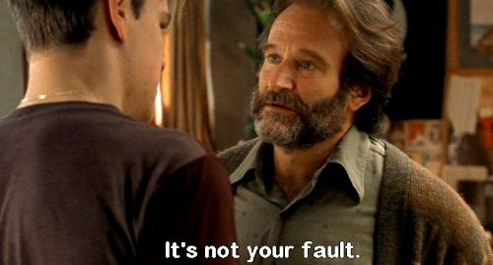

Slide 39
TRIAL STATISTICS
“There is a joke among lawyers about the difference between jury trials in England and the United States: in England, the trial starts once the jury selection ends; in America, the trial is already over.” - https://www.nytimes.com/1994/11/29/science/study-finds-jurors-often-hear-evidence-with-closed-minds.html
“About 80-90 percent of jurors make up their minds about how they are going to vote at the conclusion of opening statements.”
- Opening Statement: Setting the Tone for Trial (2019). Advocate Magazine. https://www.advocatemagazine.com/article/2019-january/opening-statement-setting-the-tone-for-trial

Slide 40
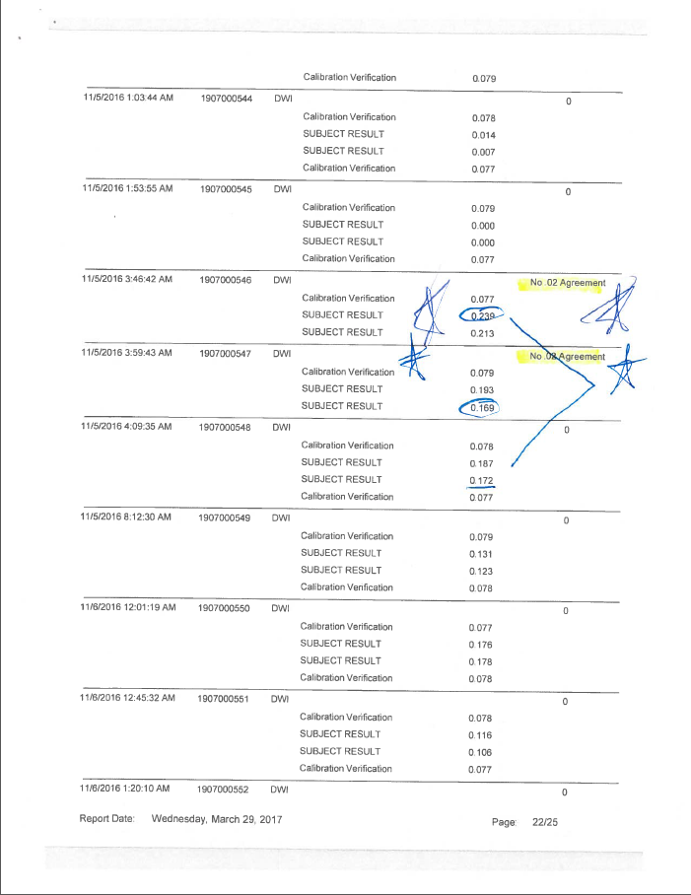

Slide 41
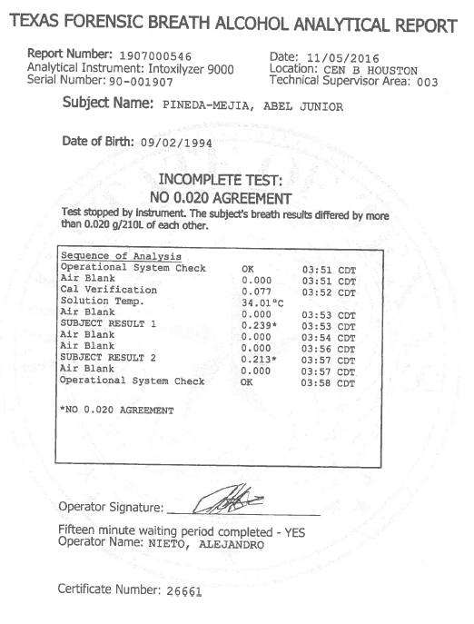
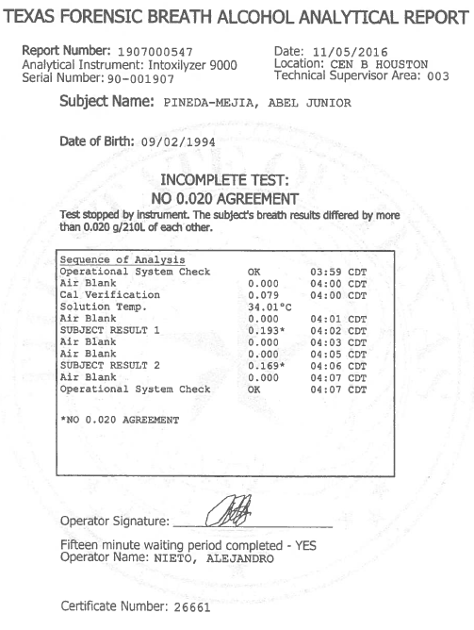
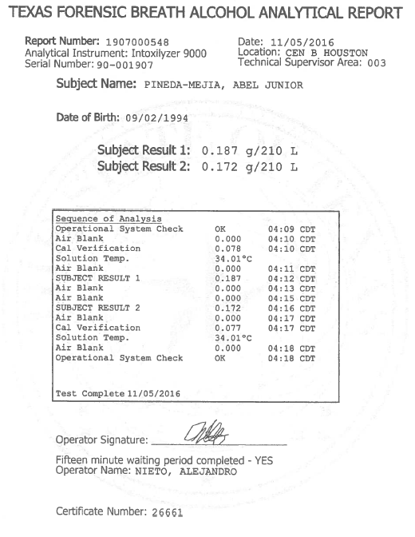

Slide 42
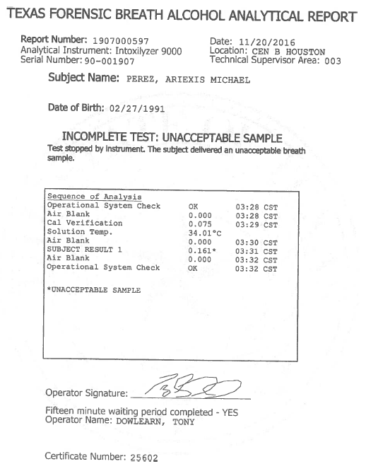
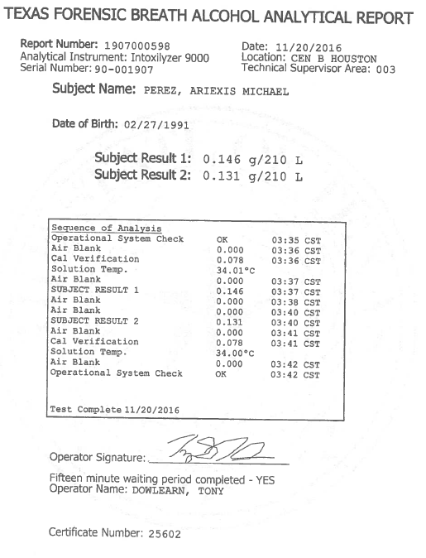

Slide 43
TRIAL STATISTICS
“These jurors decide on a version of events based on a preliminary story they find convincing, often at the time of the opening arguments, which then colors their interpretation of the evidence so much that they seize on whatever fits their verdict and discount the rest.” - NYT

Slide 44
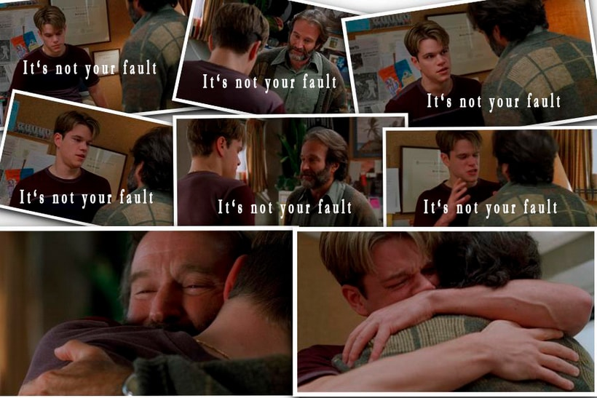

Slide 45
RETROGRADE
Ask the analyst or State before
Veliz v. State, 474 S.W.3d 354 (Tex. App.—Houston [14th] 2015). (Roe and Grecco)
  2 beers/ .081 Blood / Time of Stop / Blood Draw 3.5 hours later
  NO first, last, or food
  Mata / failed to prove reliability by C&C
Absorbing AT TIME OF DRIVING?

Slide 46
WAS MR. SMITH INTOXICATED AT THE TIME OF DRIVING?
“I DON’T KNOW” -Aubel
↑ ↓ ↔ % ?

Slide 47
RETROGRADE EXTRAPOLATION
FACTS
1st DRINK
ATE
LAST DRINK
STOP TIME
BLOOD DRAW
STATE SAYS
5pm / 0.000 / Beer
8pm Chicken
12am / /6th Beer
1237am /
230am / 0.187
STATE SAYS ↑
5pm / 0.000 / Beer
8pm Chicken
= 18+ Beers
12am / /6th Beer
230am / 0.227
= 11 beers in system at time of draw
430am / 0.187
STEPHEN SAYS ↓
5pm / 0.000 / Beer
8pm Chicken
12am/ 6th Beer = 0-.02
230am / 0.000
430am / 0.187

Slide 48
WHAT DOES HE LOOK LIKE ON THE VIDEO??
DOES HE LOOK LIKE A 0.227 OR A 0.000??

Slide 49
DRUGS and DWI
“The concentration at which the drug is present shouldn’t be an issue, because it isn’t possible to relate a concentration to ‘impairment’ with any degree of reliability.”
(NHTSA DRE Manual IV 27-28)

Slide 50
DRUGS and DWI
“[C]hemistry basically cannot supply the ‘magic number’ of impairment for drugs.” (NHTSA DRE Manual IV-27)

Slide 51
DRUGS and DWI
“[t]oxicology cannot produce “per se” proof of drug impairment.”
“[t]he chemist can’t analyze the blood or urine and come up with a number that ‘proves’ the person was or wasn’t impaired.”
(NHTSA DRE Manual IV-26)

Slide 52
DRUGS and DWI
“Another limitation of toxicology, is that it doesn’t provide evidence of the time at which the drug was ingested. Therefore, they will not be able to prove direct evidence of the subject’s condition at the time of arrest.” (NHTSA DRE Manual IV-27)

Slide 53
DRUGS and DWI
“[i]t is possible that a ‘positive’ chemical test reflects drugs that the subject took long before being arrested, and that were metabolized and no longer causing impairment prior to his or her arrest.” (NHTSA DRE Manual IV-27)

Slide 54
MIRANDA
“They never read me my Miranda rights…”
And then you Mirandized my client?
Closing: They EVER even Mirandized him!

Slide 55
HOSPITAL BLOOD
WHOLE BLOOD/ PLASMA/ SERUM
“overall mean distribution ratio of water (serum/blood) was 1.16:1” (1.08 and 1.21)
  Garriott’s Medicolegal Aspects of Alcohol p. 55 (6th Edition)
Lactate/ Lactate Ringers Solution Affect
No Way to Tell How High

Slide 56
WHOLE BLOOD TEST
Educational Background
No One Watching You
Puppet for the State
Scientific Method
AXION
Problems with the Run
DNA? Retest? Look Like It?
Switch Vials?
Show Me With Your Fingers…

Slide 57
CLOSING
Call Them By Name
Look Them Each in the Eyes
___ Days Been Waiting for You
We Need Your Help
Want You to Remember it for Ever…
Be Proud of Your Verdict
Stay Strong/ When I Sit Down
Right Verdict
Not Guilty

Slide 58
(PUNISHMENT)
1. Not Intent/ No Malice/ Not a Bad Guy
2. Live in a Glass House
3. We Go Home – He is 100% Going to Jail
4. Prison/ Cage/ Animals - Rehab
  “Prison is for people you are SCARED of;
  Probation is for people you are ANGRY with.”
5. Worst Nightmare

Slide 59

QUESTIONS??? mark@thetexastrialattorney.com cell: (832) 654-3058

