Slide 1
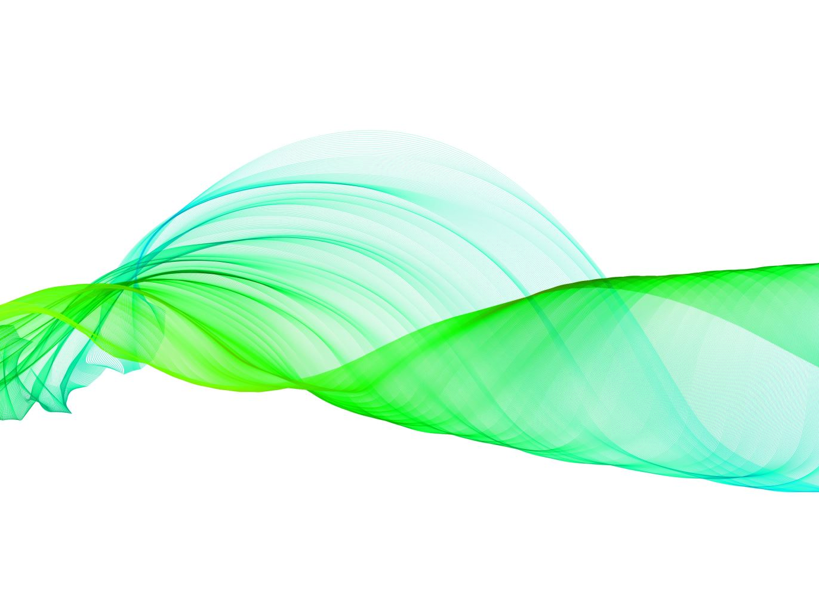
SCIENCE IN BITE SIZED CHUNKS; Images, Analogies and stories
Mark Ryan Thiessen
The Thiessen Law Firm
733 E. 12 ½ Street
Houston, Texas 77008
mark@thetexastrialattorney.com
Cell: (832) 654-3058

Slide 2
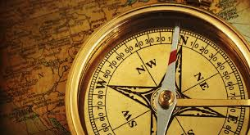
PRESUMPTION + RD = NOT GUILTY
Innocent Unless Proven Guilty
1-----→ 10
ONLY ONE PRESUMPTION
Compass takes you Home

Slide 3
BEYOND A REASONABLE DOUBT
BURDENS
OF
PROOF
CLEAR AND CONVINCING
PREPONDERANCE
PROBABLE CAUSE
REASONABLE SUSPICION
SCINTILLA
NO EVIDENCE
Notes:
Next, is reasonable suspicion. This part of the mountain trek is the part the kids can make it to. You have started to make the hike, but you really haven't made it that far. It's still not too late to turn around...
In legal sense, we look at this as what an officer has to stop someone. If you are walking down the street in the middle of Texas summer with a ski mask and a trench coat, that's reasonable suspicion to stop you. However, if it is the Texas winter like we have been experiencing, its a little more justified.

Slide 4
Beyond (if you went beyond your exit?)
A (how many pineapples do you have?)
Reasonable(phone a friend?)
Doubt (before you jump in a pool?)

Slide 5
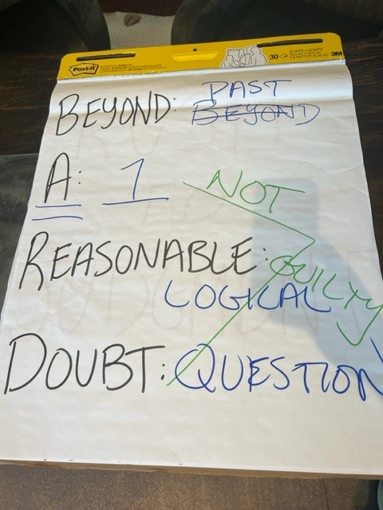

Slide 6
BEYOND A REASONABLE DOUBT
A Reasonable
Doubt
BURDENS OF PROOF
CLEAR AND CONVINCING
PREPONDERANCE
PROBABLE CAUSE
REASONABLE SUSPICION
SCINTILLA
NO EVIDENCE
Notes:
Next, is reasonable suspicion. This part of the mountain trek is the part the kids can make it to. You have started to make the hike, but you really haven't made it that far. It's still not too late to turn around...
In legal sense, we look at this as what an officer has to stop someone. If you are walking down the street in the middle of Texas summer with a ski mask and a trench coat, that's reasonable suspicion to stop you. However, if it is the Texas winter like we have been experiencing, its a little more justified.

Slide 7
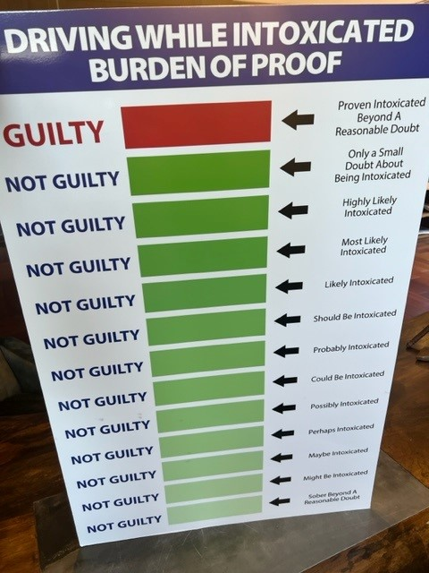

Slide 9
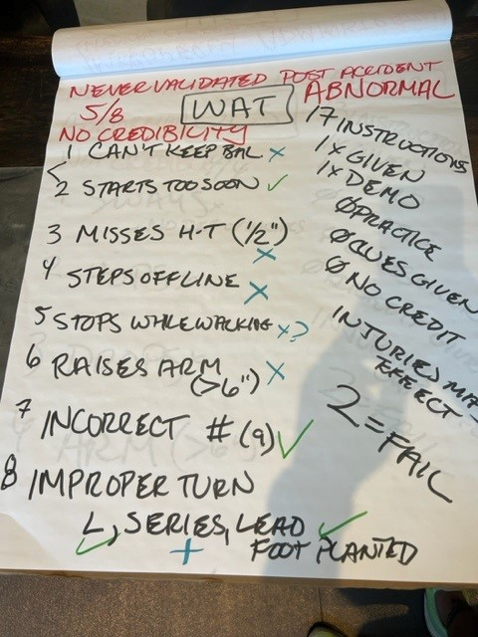

Slide 10
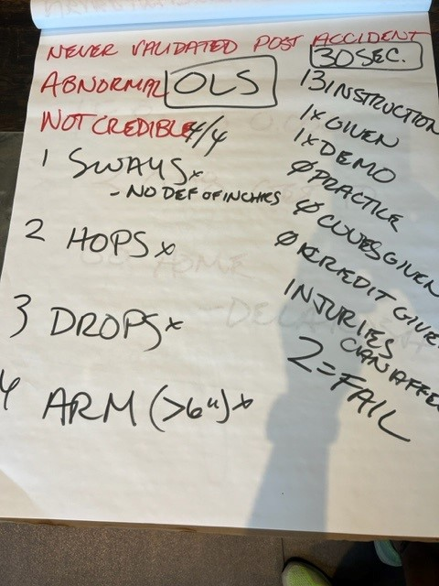

Slide 11
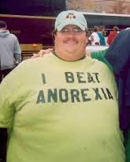
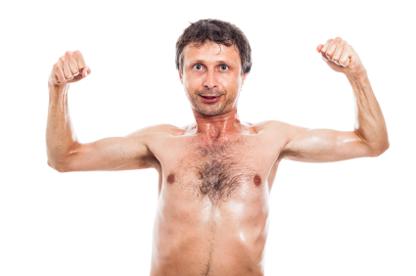
WANT TO BET?
Benches 500lbs Runs 4.5/40

Slide 12
PROVE IT!!!!!

Slide 13
HOW DO YOU FEEL ABOUT POLICE LABS?
TERRIBLE GREAT

Slide 14
TAXALYZER 9000

Slide 15
BREATH v. BLOOD
(1) 20% acceptable range of error;
(2) self checking for accuracy;
(3) no warranty for merchantability or accuracy;
(4) citizen cannot purchase from manufacturer;
(5) manufacturer refuses to provide source code;
(6) not available for independent scientific testing;
(7) destroys the only direct evidence of sobriety/intoxication when the State had the ability to save that evidence;
(8) operator has no idea how the machine works;
(9) “scientist,” who does, rarely checks it in person;
(10) any inconsistencies or strange occurrences found in test records; etc…
(1) contamination in the blood draw room;
(2) expired materials;
(3) improper site cleansing;
(4) improper blood draw technique;
(5) mishandling of the evidence;
(6) break in the chain of custody;
(7) human error in the laboratory;
(8) pipette problems;
(9) sample expiration, contamination, or other problems;
(10) contamination in the injector port, y-splitter, columns, flam ionization detector;
(11) source code issue;
(12) sloppy chromatography,
(13) 0.000
(14) Retest?
(15) Not tested DNA or Candida

Slide 16
0.08 0.16 0.24

Slide 17
DNA TEST

Slide 18
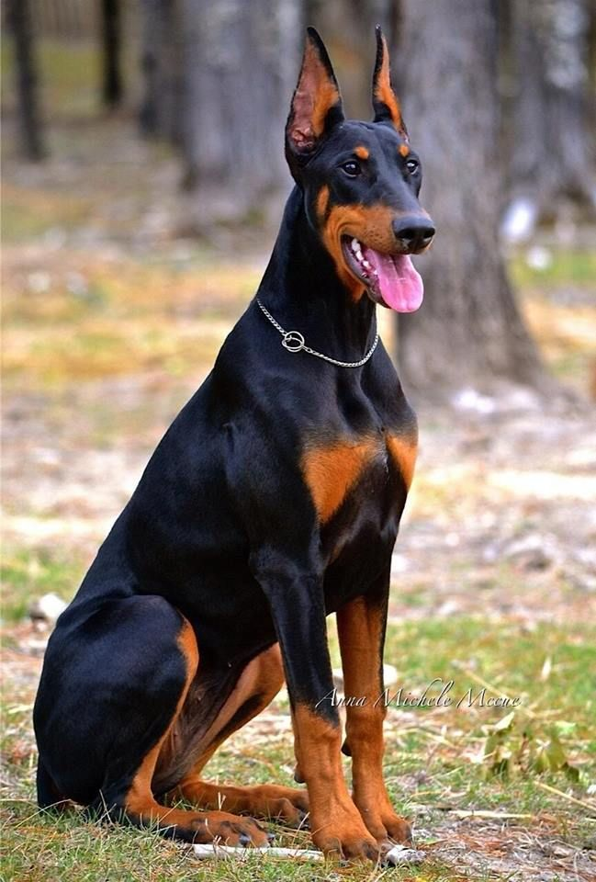
DNA TEST

Slide 19
DNA TEST

Slide 20
DOES IT LOOK LIKE A DOBERMAN?
“I DON’T KNOW”
“I DON’T LOOK”
“MY TEST IS ACCURATE”

Slide 21
MUST
VISUALLY CHECK

Slide 22
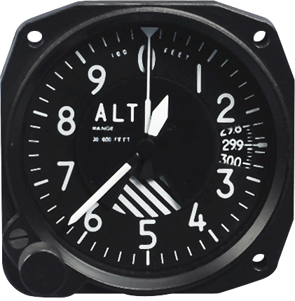

Slide 23
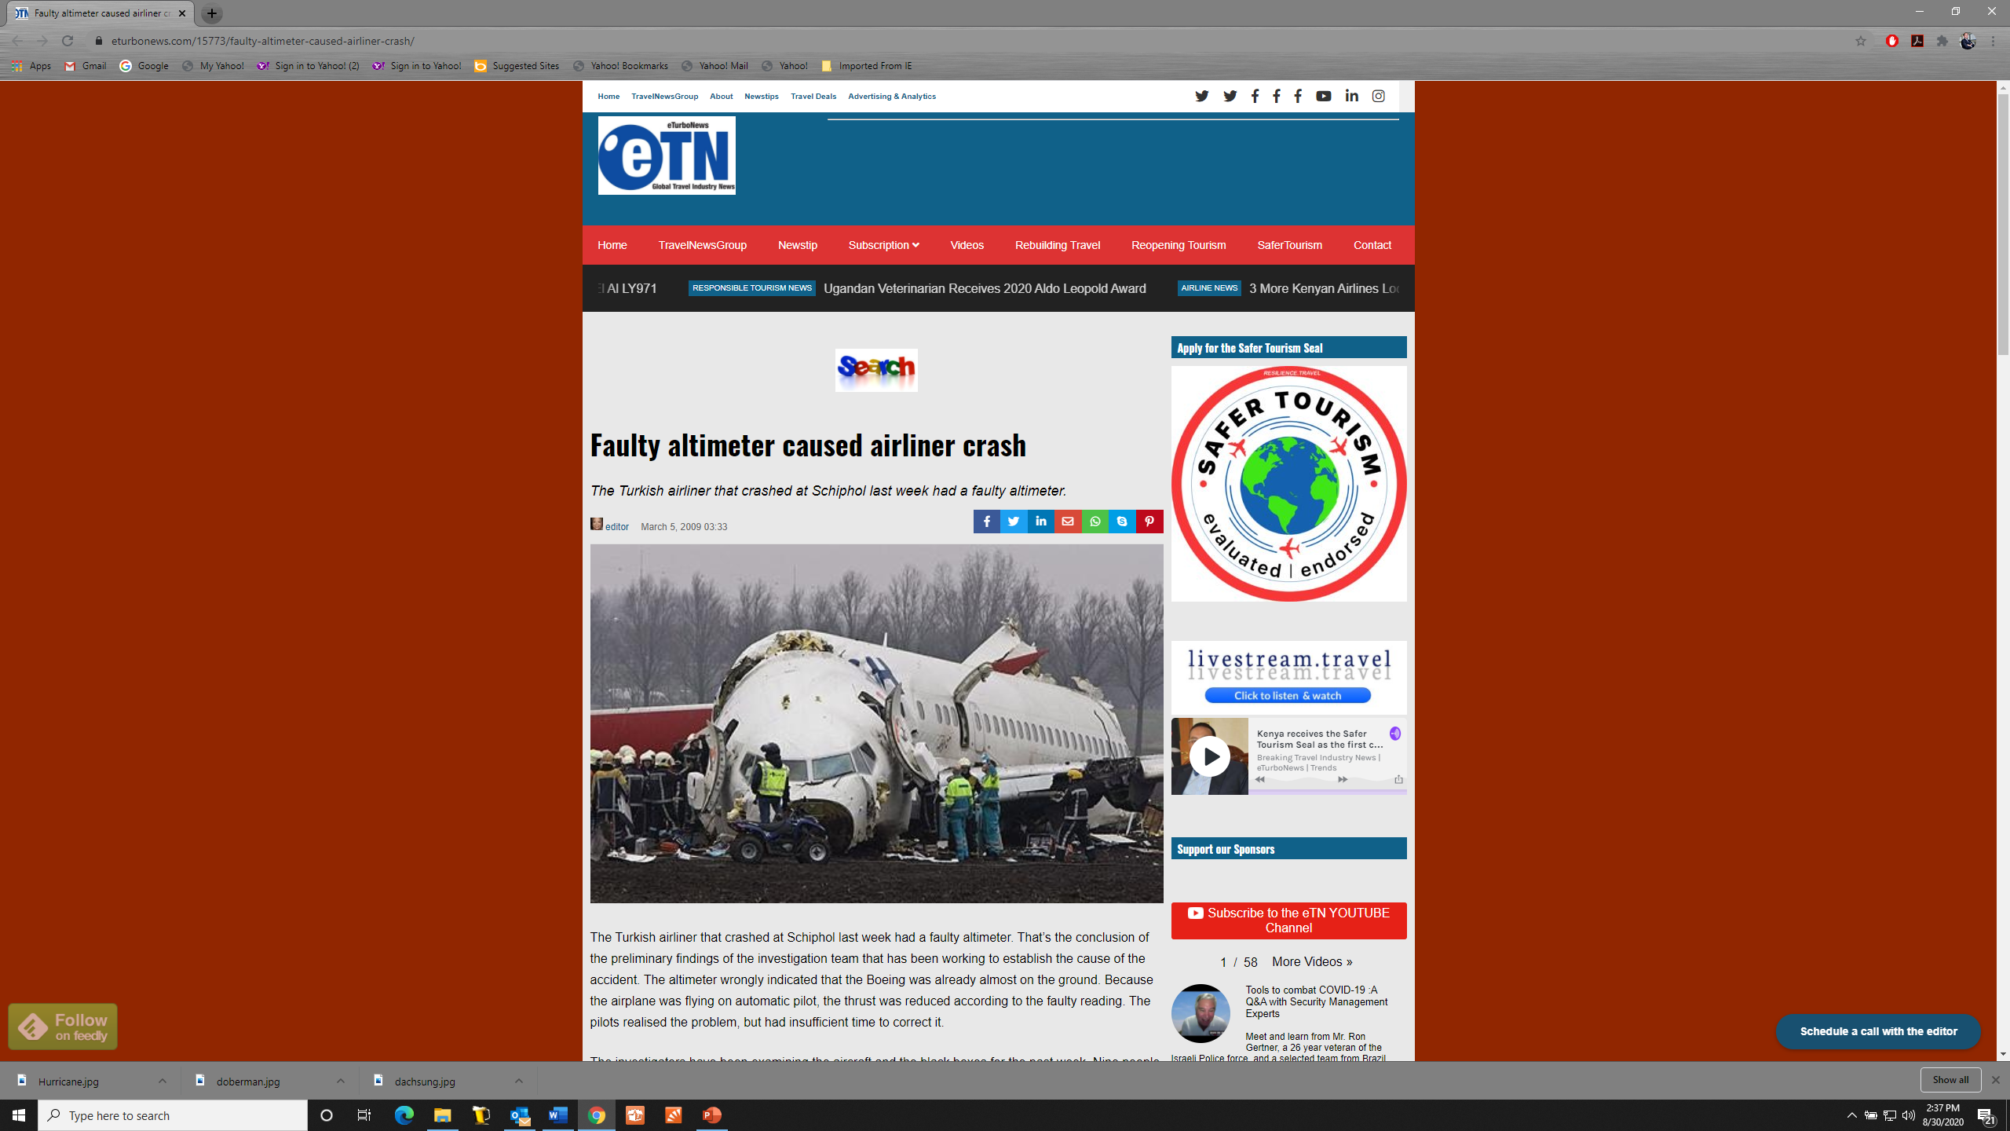

Slide 24
BAD
PREDICTIONS

Slide 25
DOPPLER RADAR

Slide 26
DOPPLER RADAR

Slide 27
FAULTY TESTS

Slide 28
COVID TEST

Slide 29
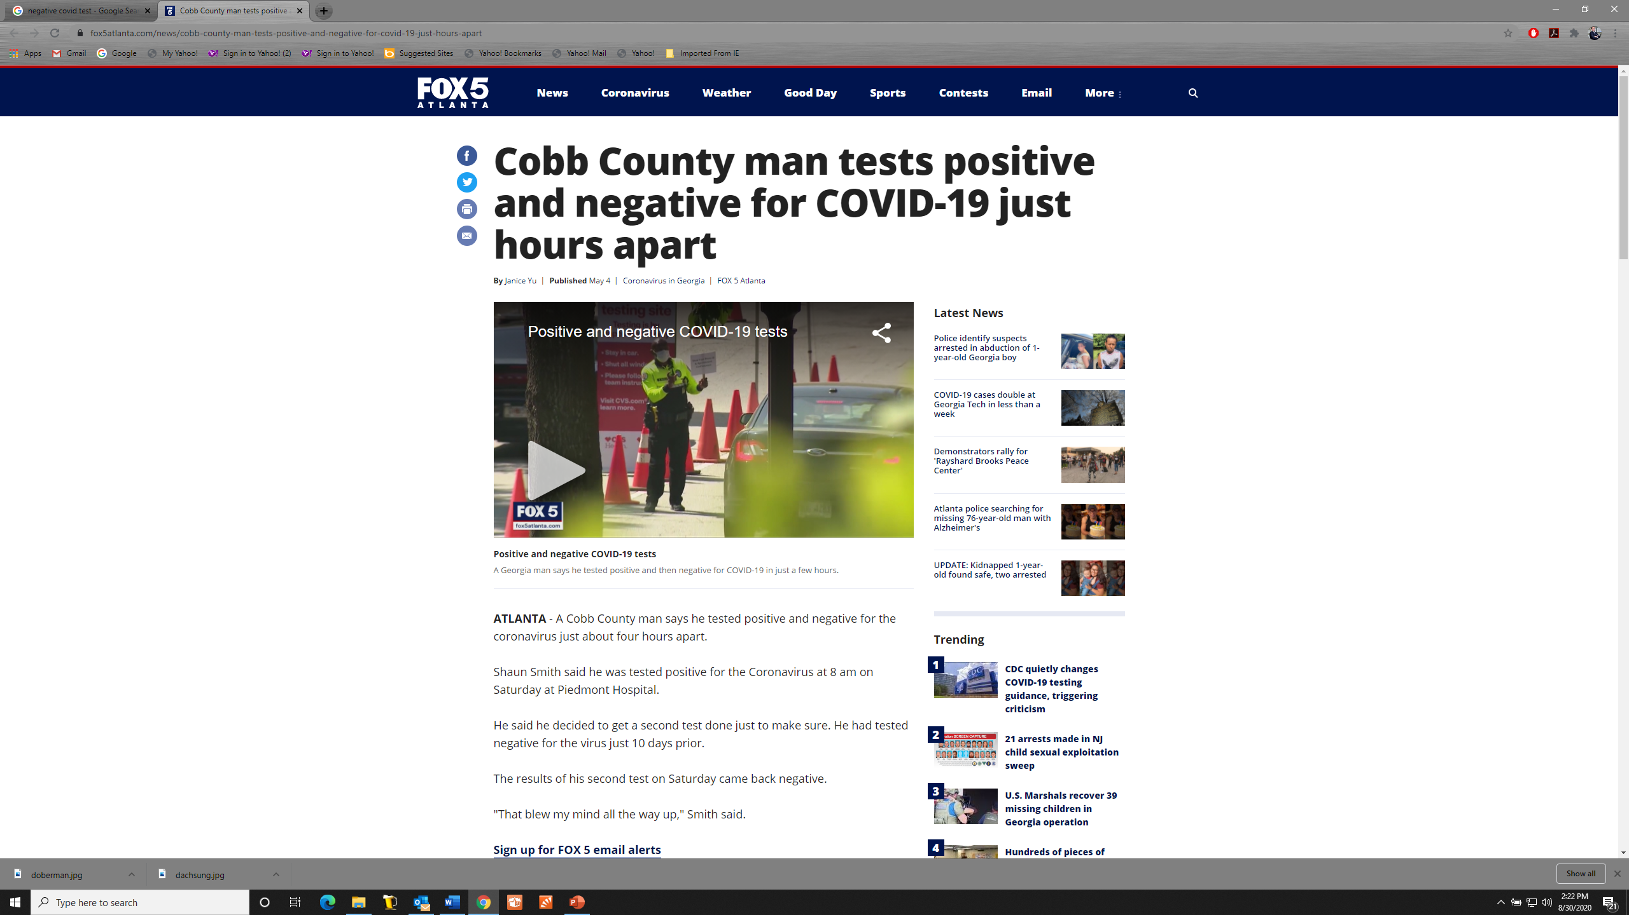
COVID TEST

Slide 30
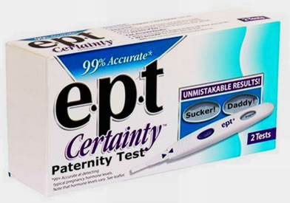
Is any test really error proof?
hCG (human Chorionic Gonadotropin), a hormone present in urine only during pregnancy.
Notes:
HYPO: MY FRIEND AND HIS WIFE JUST GOT MARRIED AND ARE TRYING TO START A FAMILY. THEY HAVE BEEN TRYING FOR AWHILE. HIS WIFE TOOK A PREGNANCY TEST THAT SHE WAS TOLD WAS ERROR PROOF, AND IT SAID THAT SHE WAS PREGNANT. SO SHE WENT TO THE DOCTOR TO BE SURE. THE DOCTOR EXAMINED HER, AND UNFORTUNATELY TOLD HER SHE WASN’T. HAS ANYONE EVER BEEN MISDIAGNOSED BY A MEDICAL TEST?

Slide 31
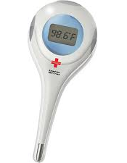
THERMOMETER
102-104 °F Go to the Emergency Room
106 °F Emergency Medical Procedures
108 °F Convulsions and Death

Slide 32
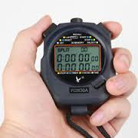
BLOOD TESTING
Stop Watch (4.5 – 40 yard dash)
Work for the parents/ Not NCAA Independent
Not 1 student at a time
Not by Name but by Number
Don’t measure the speed / Ladainian Tomlinson
Don’t even know if the student looks fast
No one checks my work
Never made a mistake
How does that make you feel?

Slide 39
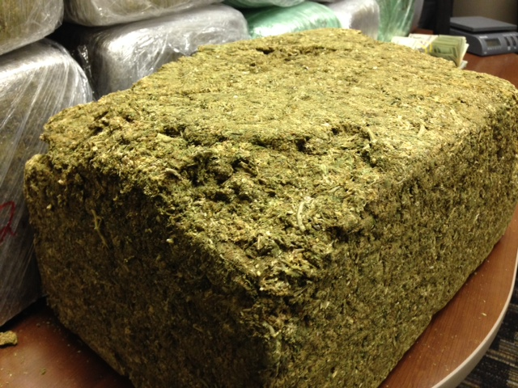

Slide 40
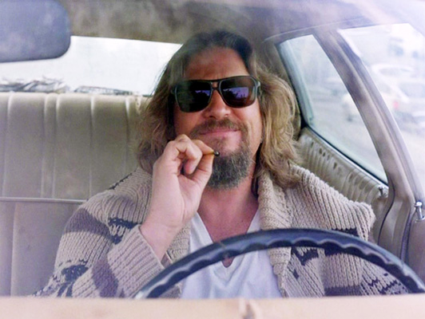

Slide 41
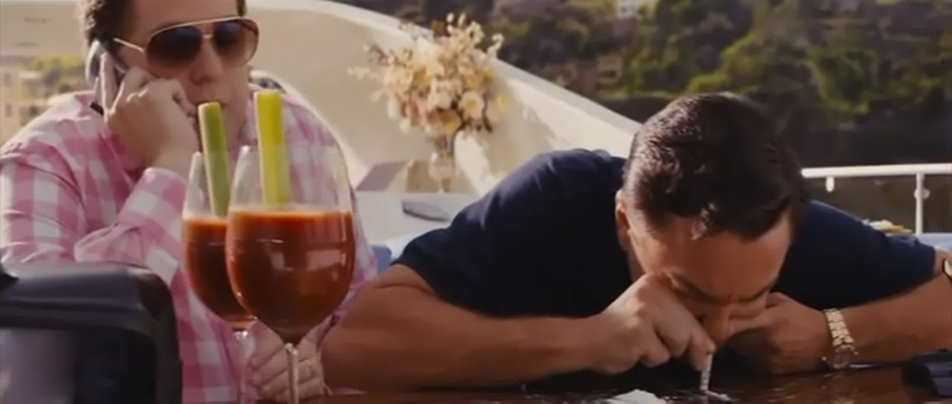

Slide 42
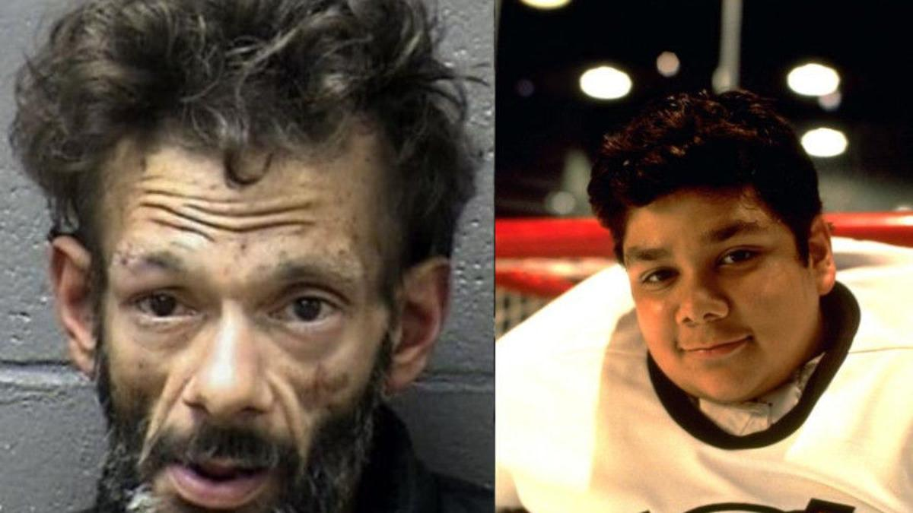

Slide 43
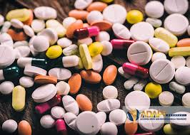

Slide 44
JURY NULLIFICATION

Slide 46
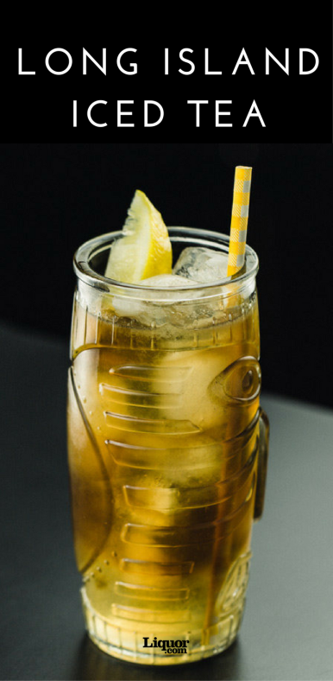
DOES IT MATTER?
OR

Slide 47
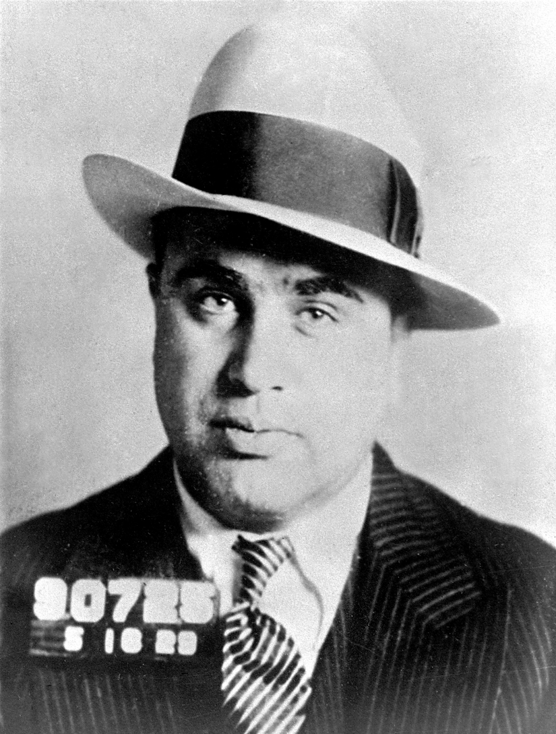
DOES IT MATTER?
OR

Slide 48
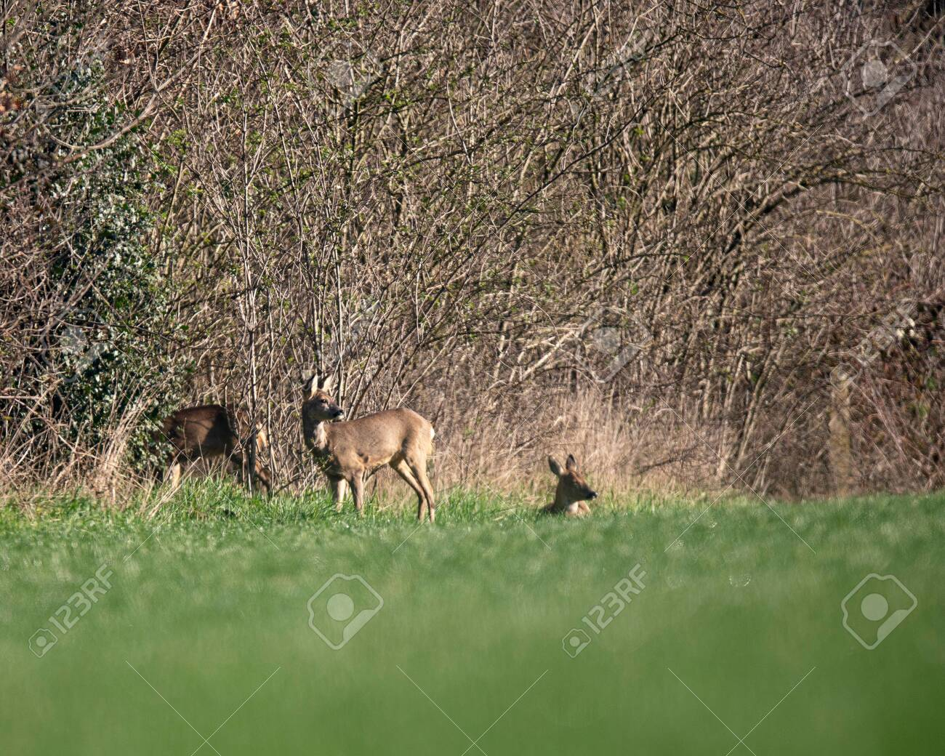

Slide 51
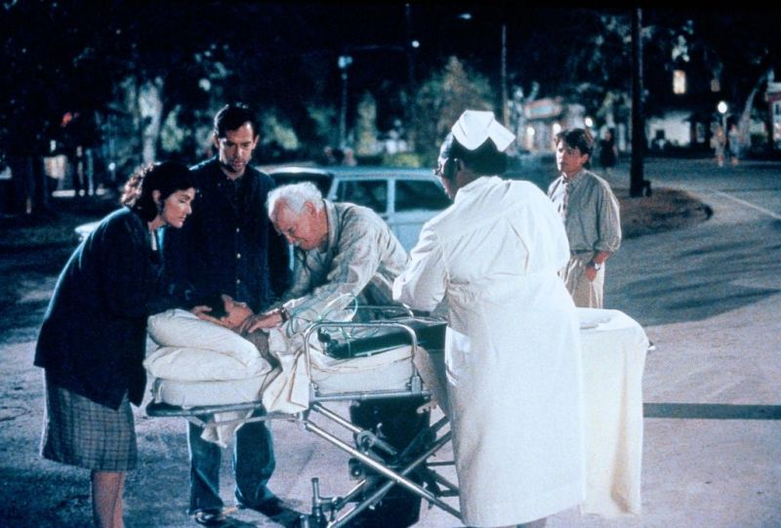

Slide 52
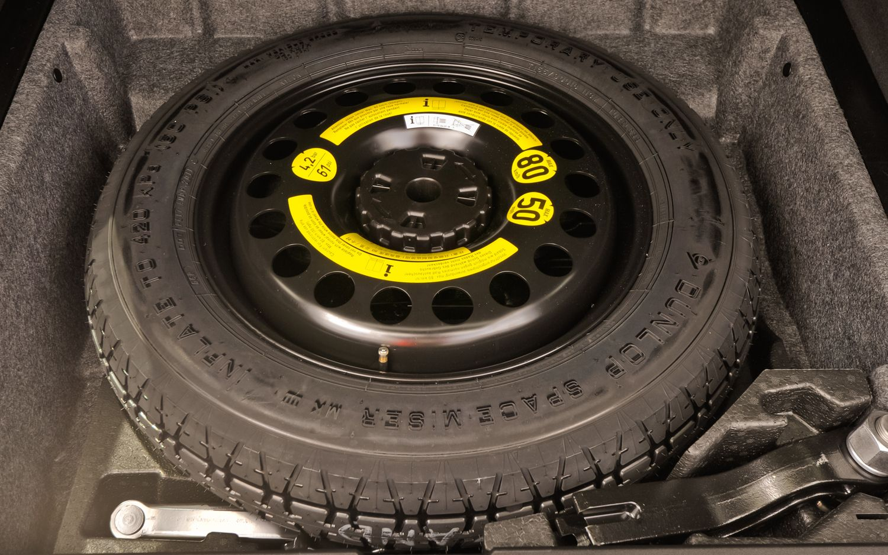

Slide 53
QUESTIONS??? mark@thetexastrialattorney.com cell: (832) 654-3058

